Slide 1
Understanding the Basic Concepts of Scripting and Software Development
By David Kimani

Slide 2
Overview
To work successfully as a penetration tester, you need to be familiar with coding, most specifically scripting languages, although knowledge of common compiled languages is also a plus. There are two major reasons for this. First, malware is code. Some of it is compiled code, and much of it is scripts.

Slide 3
Logic Constructs
Loops - repeatedly execute a section of code
Conditionals - programming language commands that are used for handling decisions (if) statement
Boolean operators - simple words (AND, OR, NOT, or AND NOT) that are used as conjunctions
String operators - allow you to manipulate values of variables in various useful ways
Arithmetic operators - perform mathematical operations

Slide 4
Data Structures
JavaScript Object Notation (JSON): JSON is a lightweight format for storing and transporting data that is easy to understand
Arrays: An array is a special variable that holds more than one value at a time
Lists: A list is a data structure in programming languages that contains an ordered structure of elements.
Trees: A tree is a non-linear data structure represented using nodes in a hierarchical model.

Slide 5
More definitions
Libraries - collection of resources that can be reused by programs
procedure - a section of code that is created to perform a specific task
Function - a block of code that is very useful when you need to execute similar tasks over and over
class - a code template that can be used to create different objects

Slide 6
Want to learn?
Two of the best ways to become familiar with Bash, Python, Ruby, PowerShell, Perl, and JavaScript languages are by creating your own scripts and inspecting scripts created by others.
at https://www.exploit-db.com.

Slide 7
Popular Pentest Programming Languages
JavaScript
Ruby
PowerShell
Python
Bash

Slide 8
Lab 10.1.19
Running this command: nmap -sV --script vulners --script-args mincvss=4 10.6.6.23
What do we see?
Runs a vulnerability scan. Checks for known vulnerabilities (CVEs) based on the detected software versions. Limited to vulnerabilities with a CVSS score of >=4
(CVSS) - Common Vulnerability Scoring System
Uses GVM scanner (Greenbone Vulnerability Management) - an open-source framework used for vulnerability scanning and management.

Slide 9
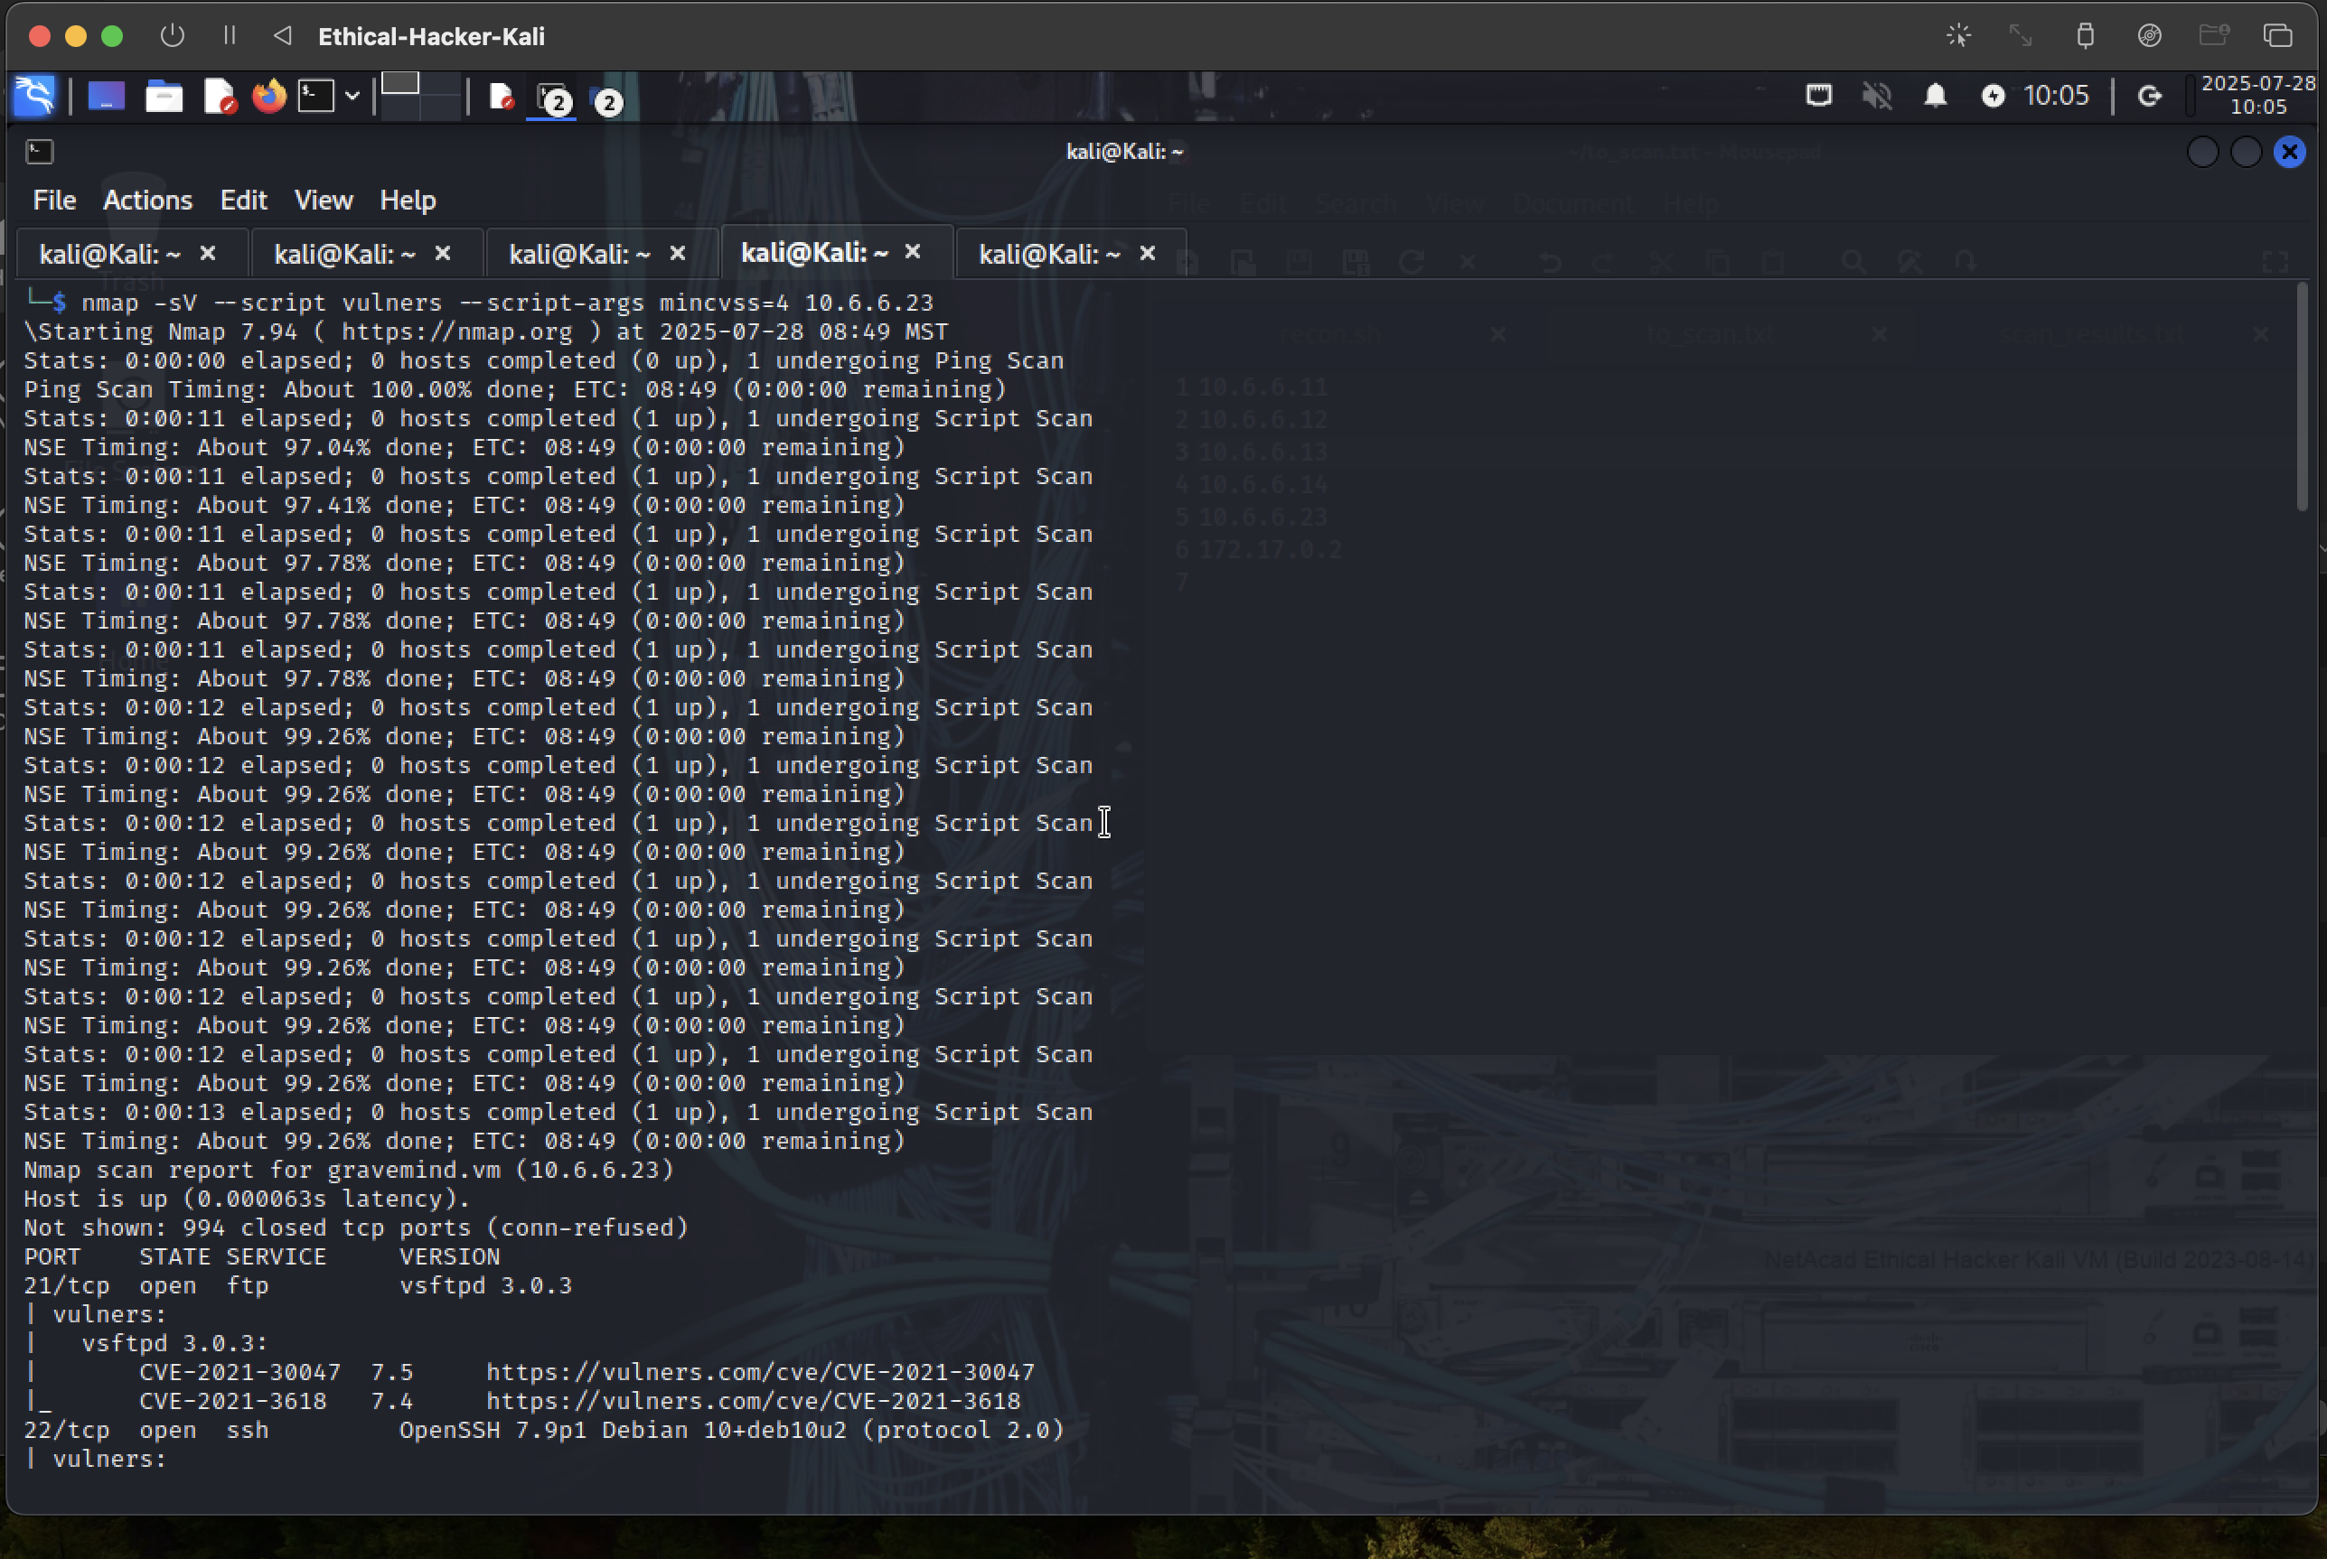

Slide 10
Lab 10.1.19
Run this command: nmap --script smb-enum-users.nse -p139,445 10.6.6.23
What do we see?
We get a list of user accounts via the SMB (Server Message Block) protocol on a target system

Slide 11
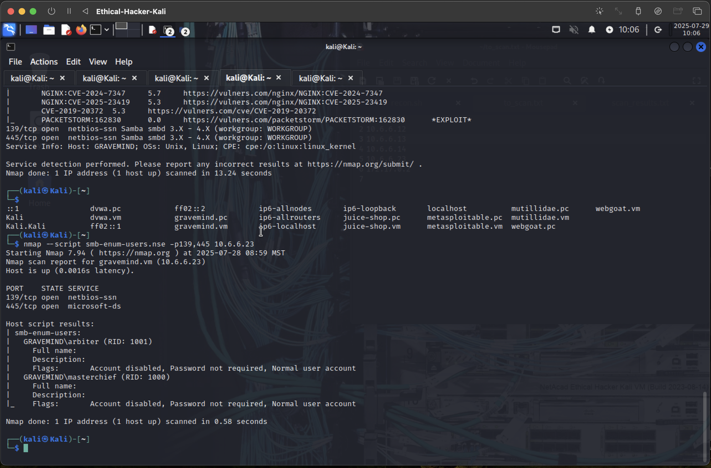

Slide 12
Lab 10.1.19
Run this command: smbclient //172.17.0.2/tmp smb: >put malicious_file.txt malicious_file.txt
What do we see?
We see a transfer of files between systems using the smbclient utility

Slide 13
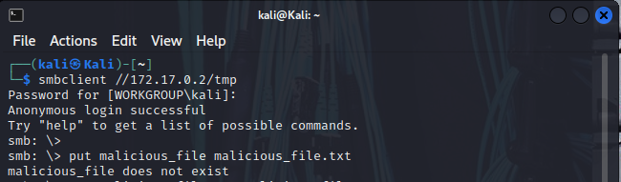

Slide 14
Lab 10.1.19
Run this command: 1' OR 1=1 UNION SELECT user, password FROM users #
What do we see?
It’s an SQL injection exploit. The purpose is to retrieve usernames and passwords from a database table called “users”

Slide 15
Conclusion
What’s the importance of being familiar with exploit code in various scripting languages?
Ethical Hackers may need to create or use exploit scripts in order to assess the security of various systems, including web applications.

